Slide 1
Automatic fly swatter
Hunter Montalvo, Sneha Patel, Jocelyn Crum
Github
Timeline Link: Gantt
Goal:
Our overall goal of the project was to make a fly swatter that would automatically detected a fly (or any other small object) in a given radius and immediately swing down, hitting the target.
GPIO:
We used 2 sonic sensors and coded them to detect movement and objects between 17 and 25 cm from them which is where the head of the fly swatter will land. We then used stepper motor coupled with some 3d printed gears to make the swing of the swatter faster.

Slide 2
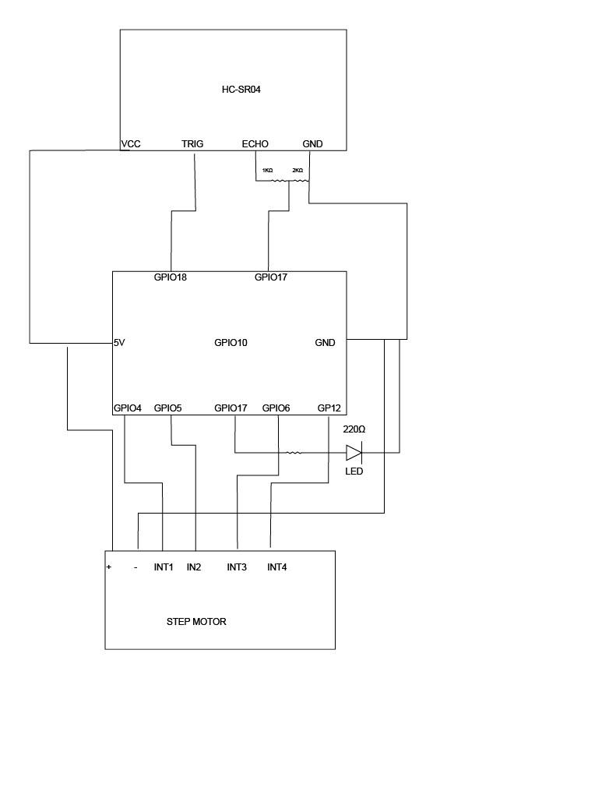
Circuit Diagram

Slide 3
If we had more time…
We learned…
Use the laser to build housing for the motor and wiring
Make it so it swats backwards and forwards
Have it on a rotating 360 degree platform
Extend the range of detection and attach a larger DC motor and swatter.
That we needed to change the code quite often to accommodate the real life variables.
About the magic of a hot glue gun
How to work and code as a group while still keeping everything organized and working
How to use a 3d printer

Slide 4
Materials:
Motor
Swatter
Body + gears
Raspberry Pi
2 sonic speakers
Wires, resistors, led light
LOTS of glue
LOTS of tape

